Slide 1

11th Grade Presentation
Preparing for your Next Steps
2019-2020

Slide 2

Agenda
Resources and Upcoming Events
College Options and Admission Requirements
Standardized Testing: SAT and ACT
College Admissions Game
College Exploration Tools
FAFSA
Building a College List

Slide 3
Resources & Upcoming Events
Resources
Aeries
Counseling Website - 11th Grade Page & 11th Grade Monthly Counseling Calendar
Daily Bulletin
CCA website & CCA Calendar
College Worksheet
College and Career Resources
Spring Events
  SDUHSD College Fair
    April 17th at the Del Mar Fairgrounds
  Fall Events
  12th Grade College Application Presentation
  UC, CSU & Common Application Workshops
  We recommend that you do not submit any materials in the fall until you have attended these sessions.

Slide 4

4 Year University (UC, CSU, Private, Out of State)
Community College
Military
Vocational or Trade School
Workplace
Gap Year
Post Graduation Options

Slide 5
Community College
Admission Requirements: High school diploma or its equivalent, and/or 18 years of age
SAT/ACT are not required.
Benefits - smaller class sizes and lower costs. It may be a good fit for students who aren’t sure what they want to study or students who want to prepare for a career like culinary arts, cosmetology or audio tech.
Students can earn professional certificates, associate degrees and/or participate in transfer programs, including the UC TAG.
Students who are not admitted to their first choice college or do not receive sufficient financial aid may attend and transfer with higher acceptance rates.
Visit the CCA Community College page for more information.

Slide 6
SDUHSD
Graduation Requirements
SUBJECT | Credits | Terms
ENGLISH | 40 Credits | 4 Terms
SOCIAL SCIENCE (World, US, Gov/Econ) | 30 Credits | 3 Terms
MATHEMATICS * | 30 Credits | 3 Terms
SCIENCE (1 Life, 1 Physical) | 20 Credits | 2 Terms
FINE/PERFORMING ART | 10 Credits | 1 Term
PHYSICAL EDUCATION ** | 20 Credits | 2 Terms
PRACTICAL ART (CTE) | 10 Credits | 1 Term
ELECTIVES | 70 Credits | 7 Terms
TOTAL | 230 Credits ***
*Must pass Integrated Math I (requirement can be met in 8th grade but middle school classes do not count toward 30 high school math credits) **Must pass State-mandated Health curriculum
You can review your transcript and graduation status by using the Aeries portal.

Slide 7
4-Year University Options
California Public Universities
  California State Universities (CSU’s)
    23 CSU campuses
  University of California (UC’s)
    9 UC campuses
Out-of-State Public Universities
Private Universities

Slide 8
UC/CSU A-G Subject Requirements
A l History/Social Science – 2 years required
B l English – 4 years required
C l Mathematics – 3 years required, 4 years recommended
*Must complete Algebra I, Geometry, Algebra 2 or Integrated Math 1-3
D l Laboratory Science – 2 years required, 3 years recommended
*Two years of laboratory science providing fundamental knowledge in at least two of these three foundational subjects: Biology, Chemistry and Physics
El Language Other than English – 2 years required, 3 years recommended
*Two years of the same language other than English
Fl Visual and Performing Arts (VPA) – 1 year required
*A single year-long approved arts course from a single VPA discipline: dance, drama/theater, music or visual art
G l College-Preparatory Electives – 1 year required
*All courses must be completed with ‘C’ grade or higher
You can view your UC/CSU GPA on your Aeries portal

Slide 9
Cal State Universities (CSU)
Admission Requirements
Fulfill the minimum A - G subject requirements with a 2.0 minimum GPA
Fulfill the examination requirement - SAT or ACT (The optional writing component is not required for admission to a CSU)
Admission is determined by an eligibility index
Visit www2.calstate.edu/apply for more information

Slide 10
University of California (UC)
Admission Requirements
Fulfill the minimum A-G subject requirements with a 3.0 minimum GPA
Fulfill the examination requirement SAT or ACT with Writing
SAT subject exams are not required, but are recommended for some majors and may be submitted if they add value. Visit the UC website for more information.
UC requires applicants to respond to 4 Personal Insight Questions
Admission determined by Admission Index & Comprehensive Review. All UC campuses use the same 14 factors to evaluate applicants but may apply them differently and make admission decisions independently. Be sure to review the selection process of each campus
Visit University of California (UC) for more information.

Slide 11
Admissions Requirements
Out-of-State/Private University
Admission Requirements
Requirements vary so review each college, including whether they require SAT Subject exams, letters of rec. and transcripts.
Many use Committee Selection - entire student application is reviewed so extracurricular activities, portfolios, auditions and recommendations play a more significant role.
Most campuses use the Common Application, which allows students to apply to multiple campuses with a single application which includes:
        An essay (some schools require additional supplemental essays)
        Letters of recommendation from your counselor and academic teacher(s)

Slide 12

D or F Grades
If an F grade is earned in any course required for high school graduation, the course must be repeated.
Students who plan to go directly to a 4-year college are strongly advised to repeat any D grade to be eligible and to improve GPA.
For CSU/UC Admission
Students who earn a D or F grade in an A-G course that is required for admission will need to repeat the course to remain eligible for CSU/UC.
During 12th grade, students that receive a D or F grade in any course, including AP and non A-G courses, may be at risk of having their admission rescinded.
Seniors should earn C grades or better!

Slide 13

College Entrance Exams
SAT
Reading, Writing and Language, Mathematics (up to Trigonometry/IM 3)
*Optional Essay – required by some colleges
SAT Subject Tests
Subject Tests are hour-long, content-based tests that allow you to showcase achievement in specific subject areas where you excel
ACT
English, Reading, Science, and
Mathematics (up to Trigonometry/IM 3)
*Optional Writing Test – required by some colleges
Comparative Features of the SAT and ACT

Slide 14
Exam Preparation
SAT and ACT- The “best” time to take any test is when you are academically ready to do so. Review the content covered in the SAT and/or ACT and utilize their prep materials.
Free online SAT Prep
Free online ACT Prep
To determine your optimum test time, consider the following:
Completion of recommended coursework:
  English 11 or AP English Language
  Integrated Math III or Integrated Math III Honors
  *CCA recommends that students test at least once (SAT and/or ACT) in 11th grade. Students will receive their scores, and will have at least one opportunity to retest in 12th grade if desired.
SAT SUBJECT TESTS – It is recommended that students take the subject test soon after successfully completing the corresponding course
COLLEGE TESTING FAQs

Slide 15
Registering for College
Entrance Exams
Remaining Test Dates for 2019
SAT Reasoning & SAT Subject Exams ACT Exam
*Please check with each university, as testing deadlines may vary based on school, major, application deadline etc.
**Official test scores are not posted to the CCA transcript and must be ordered directly from College Board and ACT.
www.fairtest.org: A resource with a list of colleges and universities that do not require the ACT or SAT for admission.
Test Date | Registration Deadline
March 9, 2019 | February 8, 2019
May 4, 2019 | April 5, 2019
June 1, 2019 | May 3, 2019
August 24, 2019 | Not yet posted
October 5, 2019 | Not yet posted
November 2, 2019 | Not yet posted
December 7, 2019 | Not yet posted
Test Date | Registration Deadline
February 9, 2019 | January 11, 2019
April 13, 2019 | March 8, 2019
June 8, 2019 | May 3, 2019
September 14, 2019 | Not yet posted
October 26, 2019 | Not yet posted
December 14, 2019 | Not yet posted

Slide 16

College Admissions Game
More than a GPA
8 volunteers please come up on stage and select a “Role Card”

Slide 17

Choosing the Right College for YOU

Slide 18

Common College Myths
The more colleges I apply to, the more likely I am to get in
The more selective a school is to get into, the higher the quality of education
Schools that cost more are higher quality
It is easier to get into an unpopular major and then change majors
Colleges always choose the “best” students
There is only one college out there that is right for me
Students who get into “top” colleges are happier with their experience
College rankings are an objective and legitimate way to rate a school

Slide 19
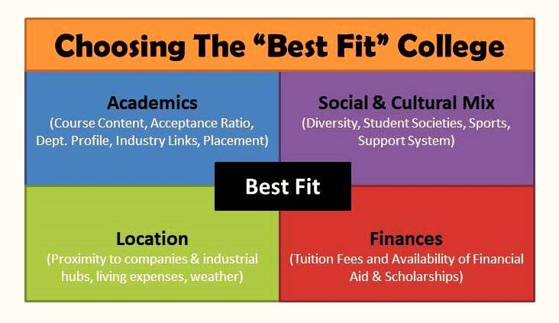

Slide 20
Free Application for Federal Student Aid
https://studentaid.ed.gov/sa/fafsa
Opens October 2019 and closes March 2, 2020
Includes grants such as the Pell Grant and Cal Grant, work-study, as well as loans
Many universities require a FAFSA on file to be eligible for institutional scholarships
Never pay anyone to do this application for you

Slide 21
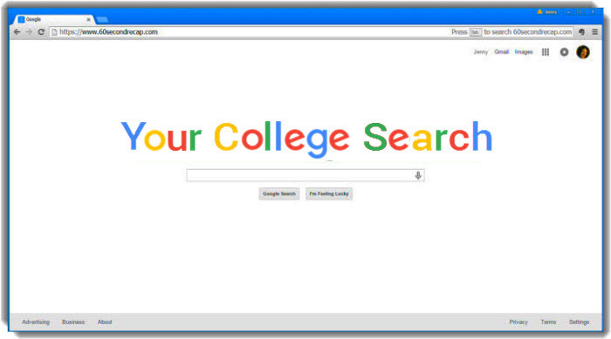
1. College Data College Search
2. College Board My Big Future College Search
3. California Colleges
4. SDUHSD College and Career Resources
5. College Search Worksheet

Slide 22

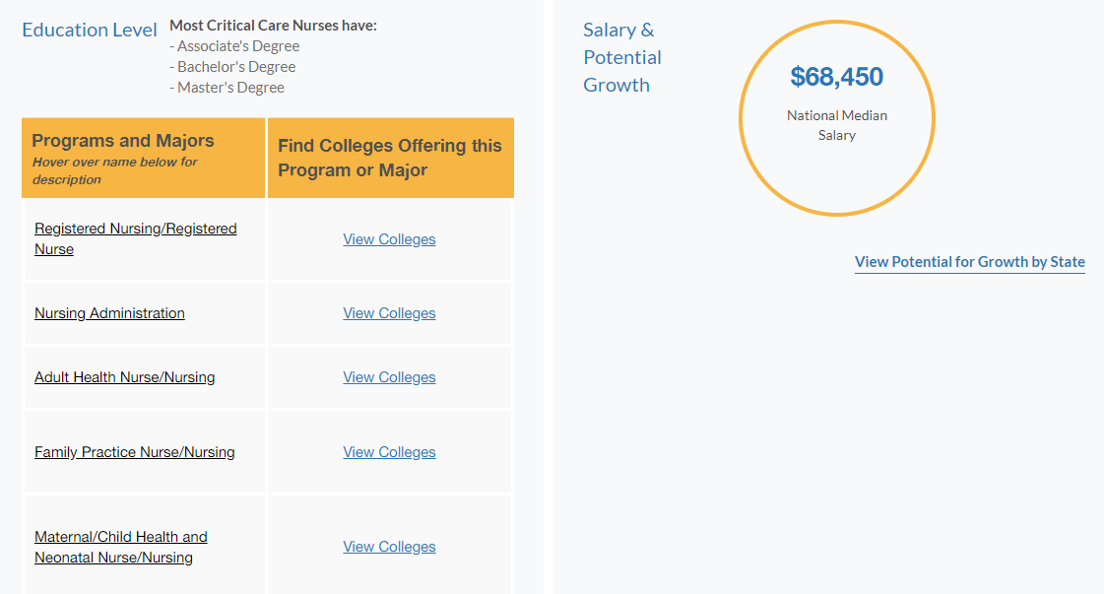
Go to www.californiacolleges.edu
Complete the “Interest Profiler” to generate a list of industries and occupational fields you may enjoy working in
Use the “Career Search Tool” to browse available jobs, and see what kind of education and training is required to work in a specific field
The College Search:
Choosing a Major
Use the “View Colleges”
feature to find colleges
that offer the major or
program of study
that you wish to pursue

Slide 23

Steps to Building a Strategic College List
Identify the fit factors that are most important to you
Utilize a college search tool to generate a list of potential schools (College Data, College Board …)
Compare your admission credentials to admitted students to determine whether a school is a “likely” “target” or “reach”, using College Data’s College Chance Calculator, or the admitted student profile published by each college for the previous class
* The most current, accurate data can be found on the college website. Admissions profiles and selectivity vary based on each year’s applicant pool

Slide 24
What Makes a Good College List?
Your list should include a broad range of schools, mostly
  “Likely” Schools – preparation well exceeds admission requirements & costs
  “Target” Schools – preparation meets or exceeds admission requirements & costs
  And a few…
  “Reach” Schools - admission is very competitive regardless of student preparation (historically low admission rates); student does not meet or exceed requirements or the school’s cost exceeds your college budget
  Use CollegeData, College Board, and the college websites* to research admission criteria and acceptance rates to compare your qualifications with those of students who have been admitted in the past.
  *Your best source is always the college

Slide 25

Next Steps
Register for SAT/ACT testing
Explore potential majors and interests
Begin college search process. Visit campuses, talk with your family, and draft a tentative list of schools you plan to apply to
We will review the process for requesting letters of recommendation, and go over the details of submitting applications in the Fall.

