Slide 1
Welcome New Ravens!!!
Incoming Student Registration Presentation

Slide 2
The CCA Counseling Department thanks the CCA Foundation for its support of Counseling, College & Career Services.

Slide 3
Agenda
Resources and Staying Informed
4 x 4 Schedule
High School Graduation & CSU/UC Subject Requirements
Course Selection Guidance
Course Selection Contract, Course List and
SDUHSD Course Selection Guidelines
AERIES Online Course Selection
Important Dates and Reminders

Slide 4
Resources & Staying Informed
CCA main website
CCA Calendar
CCA Counseling Website: Incoming Student Course Selection
Counseling, College & Career Center Newsletter

Slide 5
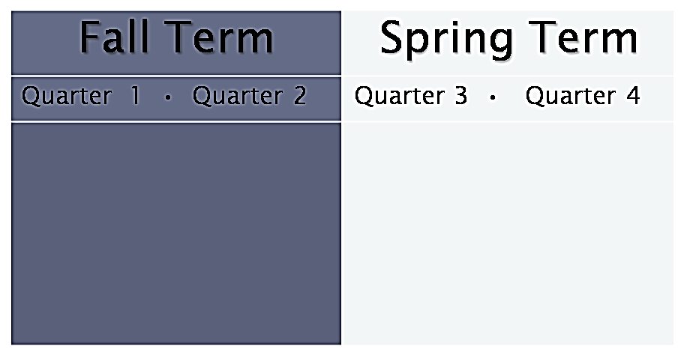
4x4 Schedule
Each 36-week school year is divided into two 18-week terms, Fall & Spring.
Each term is divided into two 9-week “quarters” which are equal to semesters on a traditional schedule.

Slide 6
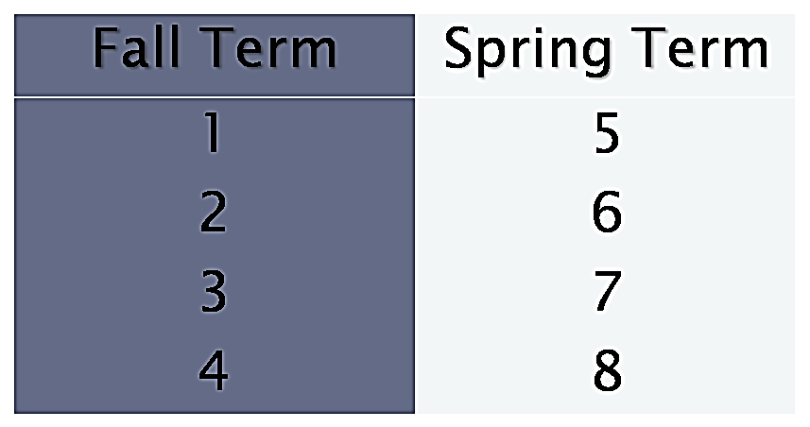
4x4 Schedule
Each course completed on the 4 x 4 block schedule is the equivalent of a year-long course on a traditional semester schedule.
Students can take 4 courses each term, for a total of 8 courses in a school year. They must take at least 3 courses each term.

Slide 7
SDUHSD
Graduation Requirements
In addition, all students must pass:
Algebra I or Integrated Math I (requirement can be met in 8th grade but middle school classes do not count toward 30 high school math credits)
California State-mandated Health curriculum

Slide 8
CSU/UC Subject Requirements
History/Social Science – 2 YEARS/TERMS REQUIRED
English – 4 YEARS/TERMS REQUIRED
C. Mathematics – 3 YEARS/TERMS REQUIRED, 4 TERMS RECOMMENDED
*Must take up to Integrated Math III or Algebra II
D. Laboratory Science – 2 YEARS/TERMS REQUIRED, 3 TERMS RECOMMENDED
Language Other than English – 2 YEARS/TERMS REQUIRED, 3 TERMS RECOMMENDED *Must be the same language
Visual and Performing Arts (VPA) – 1 YEAR/TERM REQUIRED
College-Preparatory Electives – 1 YEAR/TERM REQUIRED
All courses must be completed with ‘C’ grade or higher
View the CSU/UC approved course list for CCA

Slide 9
Course Selection Guidance
1. Research classes before selecting them.
Include your grade-level requirements based on both high school graduation and college eligibility.
Review the Course Profiles and Course Progressions for specific subject areas (i.e. Math, Arts, etc.) to make sure you have met the prerequisites and department recommendations for each course.
Pay attention to the estimated homework requirement and level of difficulty for each course you request.
Talk to your current teachers or counselor if you have questions about which courses are appropriate for you.
Choose your electives wisely! Read the course descriptions to select courses in which you are genuinely interested. You will not be able to change elective courses after the school year begins.
2. Consider your extracurricular commitments (athletics, clubs, job, community service)
to determine whether you will have enough time for your courses, given the amount of time required for
your activities.
3. Consider taking a strategic unscheduled period.*
4. If you are considering taking Honors or Advanced Placement
courses, visit the Honors/AP Courses page.
5. For further guidance on selecting a Course Schedule,
visit the Schedule Advice page.
Create a balanced year-long schedule that is challenging, but not overwhelming, by selecting courses for which you are adequately prepared.

Slide 10
Sample Schedule 1
Fall Term Spring Term
English 9 | 30-60 minutes | Integrated Math I | 30-60 minutes
Biology | 45 minutes | Drawing and Design | 0-30 minutes
Spanish I | 30 minutes | Spanish II | 0-30 minutes
Year-One PE | 30 minutes | Speech & Debate | 0-30 minutes
Total | 2 hours 45 minutes maximum |  | 2 hours 30 minutes maximum

Slide 11
Sample Schedule 2
Fall Term Spring Term
English 9 Honors | 30-60 minutes | Integrated Math II Honors | 60-90 minutes
Integrated Math I Honors | 60-90 minutes | Drawing and Design | 0-30 minutes
Spanish I | 30 minutes | Spanish II | 0-30 minutes
Year-One PE | 0-30 minutes | Biology | 45 minutes
Total | 3 hours 30 minutes maximum |  | 3 hours 15 minutes maximum

Slide 12
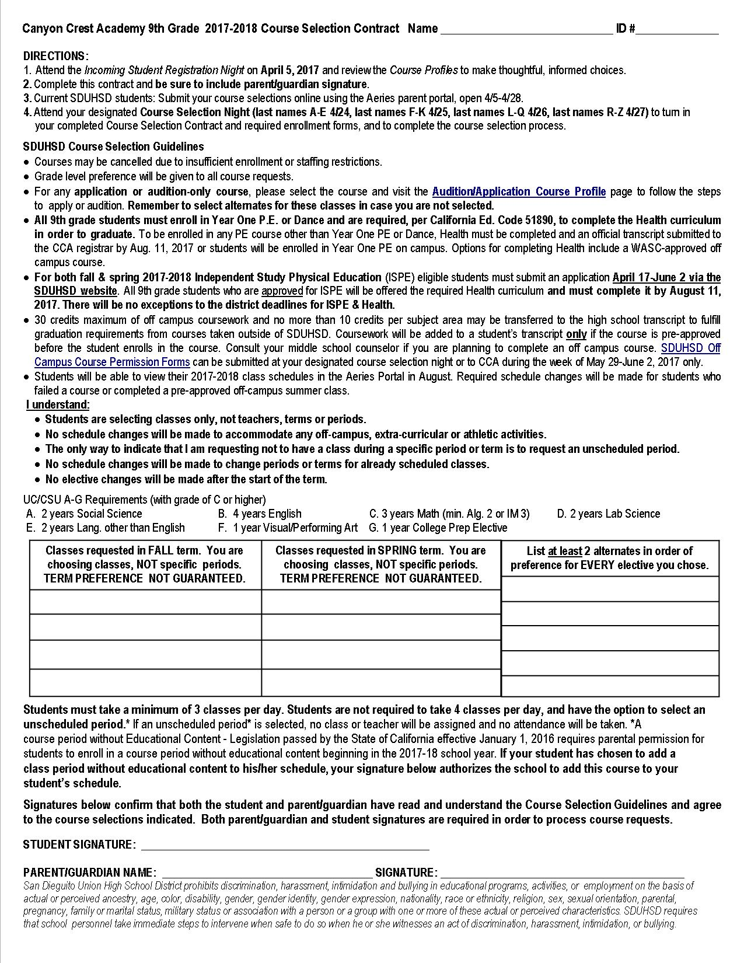
COURSE SELECTION CONTRACT
DIRECTIONS:
1. Attend the Incoming Student Registration Night on April 5, 2017 and review the course profiles to make thoughtful, informed choices.
2. Complete this contract and be sure to include parent/guardian signature.
3. Submit your course selections online using the AERIES PARENT PORTAL, open 4/5-4/28, 2017.
4. Attend your designated Course Selection Night to turn in your completed Course Selection Contract and required enrollment forms, and to complete the course selection process.

Slide 13
SDUHSD Course Selection Guidelines
Courses may be cancelled due to insufficient enrollment or staffing restrictions.
Grade level preference will be given to all course requests.
For any application or audition-only course, please select the course and visit the Audition/Application Course Profile page to follow the steps to apply or audition. Remember to select alternates for these classes in case you are not selected.
Students will be able to view their 2017-2018 class schedules in the Aeries Portal in August. Required schedule changes will be made for students who failed a course or completed a pre-approved off-campus summer class.

Slide 14
SDUHSD Course Selection Guidelines
Students must take a minimum of 3 classes per day. Students are not required to take 4 classes per day, and have the option to select an unscheduled period.*
If an unscheduled period* is selected, no class or teacher will be assigned and no attendance will be taken.
*A course period without Educational Content - Legislation passed by the State of California effective January 1, 2016 requires parental permission for students to enroll in a course period without educational content beginning in the 2017-2018 school year.

Slide 15
SDUHSD Physical Education & Health Requirement
All 9th grade students must enroll in Year One P.E. or Intro. Dance which include the health curriculum.
All students are required, per California Ed. Code 51890, to complete the State of California-mandated Health curriculum in order to graduate.
Eligible students may apply to SDUHSD for Independent Study Physical Education (ISPE).
For both Fall & Spring 2017-2018 ISPE, eligible students must submit an online application April 17-June 2 via the SDUHSD website.
All 9th grade students who are approved for ISPE will be offered the required Health curriculum and must complete it by August 11, 2017. *There will be no exceptions to the district deadlines for ISPE & Health.

Slide 16
Off Campus Coursework
Students may choose to take additional coursework off campus to supplement their CCA courses.
No student may begin to acquire high school credits until the day after the completion of the 8th grade.
No more than 30 credits and no more than 10 credits per subject area in English, math, science or social science may be transferred to a SDUHSD transcript to fulfill graduation requirements from courses taken outside of SDUHSD.
Coursework will be added to a student’s transcript only if the course is pre-approved before the student enrolls in the course.
Off campus math courses may not be used to accelerate from college prep to SDUHSD honors level math courses unless they are taken in combination with a SDUHSD Bridge course (see current counselor for bridge information).
If you plan to complete an off campus course follow the steps below:
Consult with your current middle school counselor.
Submit an SDUHSD Off Campus Course Permission Form at your designated registration night, or to CCA during the week of May 29-June 2, 2017 only.

Slide 17
Additional Course Selection Guidelines & Reminders
Students are selecting classes only, not teachers, terms or periods.
No schedule changes will be made to accommodate any off-campus, extra-curricular or athletic activities.
The only way to indicate that I am requesting not to have a class during a specific period or term is to request an unscheduled period.
No schedule changes will be made to change periods or terms for already scheduled classes.
No elective changes will be made after the start of the term.

Slide 18
Course List
Refer to the back of your Course Selection Contract for a list of courses
available for your 2017-2018 grade level.
Please note the subject areas from which you must select a course.
These subject requirements must be met for high school graduation.
Some courses will be available in one term only. This is indicated by the
course numbers next to each course.
Course numbers with no S at the end = Fall term only
Course numbers with only S at the end = Spring term only
Course numbers with /S at the end = Both terms

Slide 19
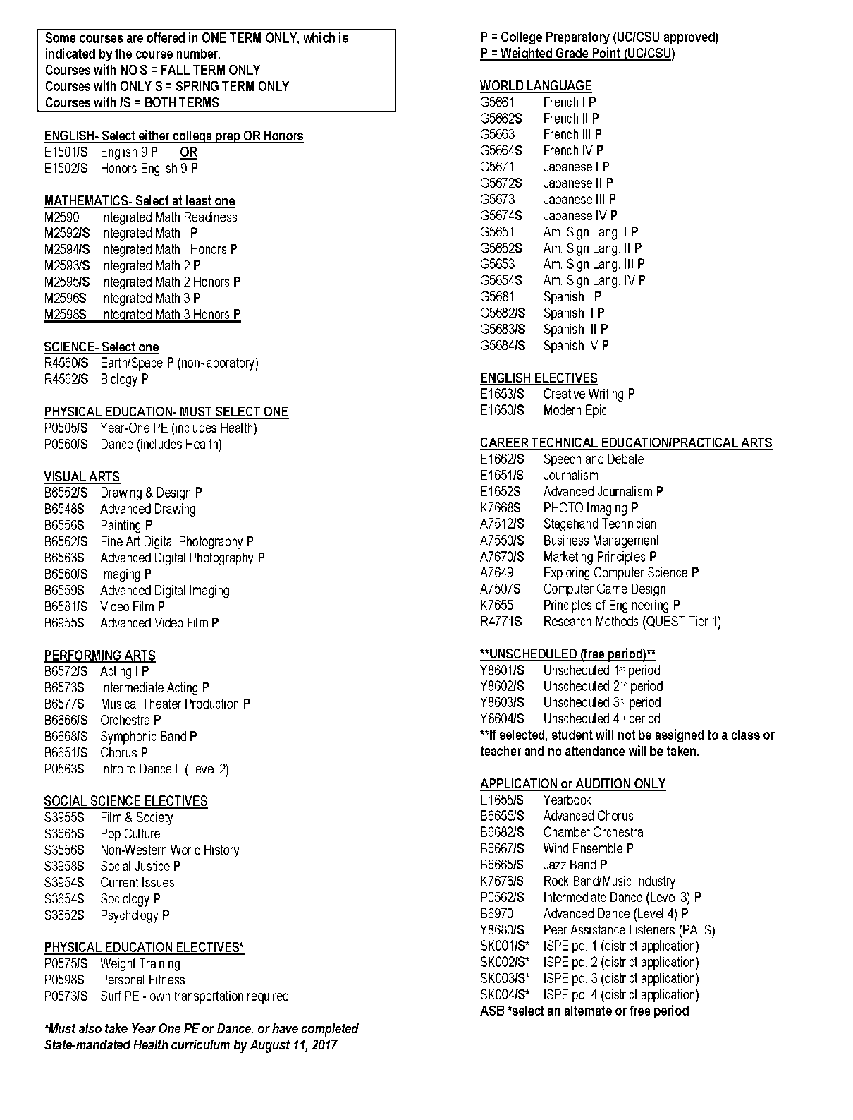
Course List
You must select one of each
grade-level requirement
P = College Preparatory (CSU/UC approved)
P = Weighted Grade Point (CSU/UC)

Slide 20
Application & Audition Only Courses
APPLICATION-ONLY
Peer Assistance Listeners (PALs)
Independent Study PE (via SDUHSD district website)
PE Credit Athletics (10-12)
Yearbook
*ASB
AUDITION-ONLY
Advanced Chorus
Chamber Orchestra P
Wind Ensemble P
Jazz Band P
Rock Band/Music Industry
Intermediate Dance P (Level 3)
Advanced Dance (Level 4)
Dance Choreography P
Refer to the Application/Audition-Only page for instructions, deadlines and materials.
Indicate the Application/Audition course you plan to take on your Course Selection Contract and online in Aeries. Choose alternates in case you are not selected.
*
Exceptions:
ASB If you plan to apply for ASB, select another course until the ASB Director confirms you have been admitted. Visit the ASB site to obtain the application and more information.
Conservatory (Grade 10-12 only)
You must apply for Conservatory. These courses take place after school and cannot be selected during online course selection. Please refer to the Envision website for application and audition information.

Slide 21
How to fill out the Course Selection Contract
List the classes you are requesting to take in the FALL Term . You are choosing classes, NOT specific periods. Term preference is considered but not guaranteed. | List the classes you are requesting to take in the SPRING Term . You are choosing classes, NOT specific periods. Term preference is considered but not guaranteed.
English 9 Honors | Biology
Integrated Math I | Year One PE
Spanish I | Spanish II
Unscheduled 4th (plan to play a Fall sport) | *Drawing and Design
List AT LEAST 2 alternates in order of preference for EVERY elective you have chosen.
*Video Film
*Stagehand Tech
* Personal Fitness
*Journalism
*Fine Art Digital Photo
Signatures below confirm that both the student and parent/guardian have read and understand the Course Selection Guidelines and agree to the course selections indicated. Both parent/guardian and student signatures are required in order to process course requests
STUDENT SIGNATURE: __________________________
PARENT/GUARDIAN NAME: ______________________ SIGNATURE: _____________________

Slide 22
How to fill out the Course Selection Contract
Use pencil to write in your classes in case changes are necessary.
Signatures must be in ink.
List the classes you are requesting to take in the FALL Term . You are choosing classes, NOT specific periods. Term preference is considered but not guaranteed. | List the classes you are requesting to take in the SPRING Term . You are choosing classes, NOT specific periods. Term preference is considered but not guaranteed.
English 9 Honors | Biology
Integrated Math I | Year One PE
Spanish I | Spanish II
Unscheduled 4th (plan to play a Fall sport) | *Drawing and Design
List 2 alternates in order of preference for EVERY elective you have chosen.
*Video Film
*Stagehand Tech
*Personal Fitness
*Journalism
*Fine Art Digital Photo
Signatures below confirm that both the student and parent/guardian have read and understand the Course Selection Guidelines and agree to the course selections indicated. Both parent/guardian and student signatures are required to process course requests
STUDENT SIGNATURE: __________________________
PARENT/GUARDIAN NAME: ______________________ SIGNATURE: _____________________

Slide 23
Online AERIES Course Selection
Students who currently attend a SDUHSD school must
Complete the paper Course Selection Contract and
Select courses online via the Aeries Parent Portal
If you do not have access to your Aeries account, contact your current school to acquire access.
The Aeries online course selection window will open Wednesday, 4/5 and close Friday, 4/28 at 3:00 pm.
If, for any reason, you do not enroll by April 28, 2017, you will forfeit your spot at CCA and you will be enrolled at your boundary high school.

Slide 24
Online Course Selection Instructions
Log-in to the Parent/ Guardian Aeries Account.
Use your completed Course Selection Contract as a guide to ensure the same courses are selected online.
Use the following slides to help with the online course submission.

Slide 25
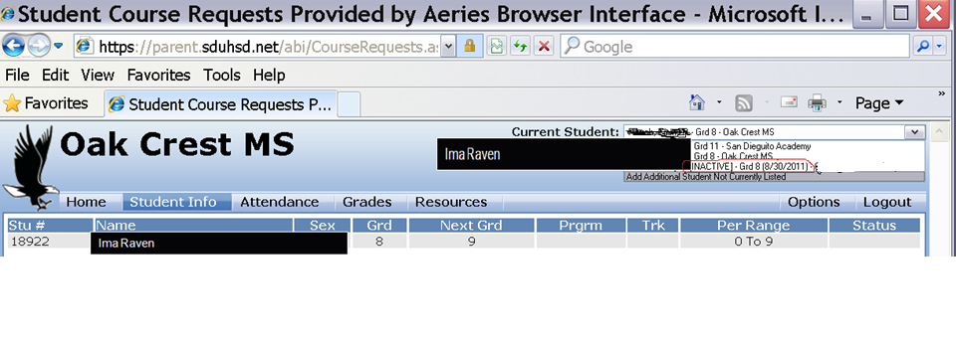
Canyon Crest Academy
Select STUDENT NAME AND INACTIVE cca RECORD

Slide 26
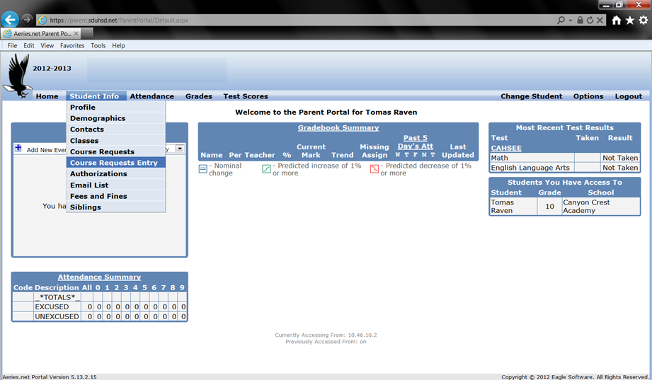
Online Registration Instructions
Oak Crest MS
1. Select “Student Info”
2. Select “Course Requests Entry”

Slide 27
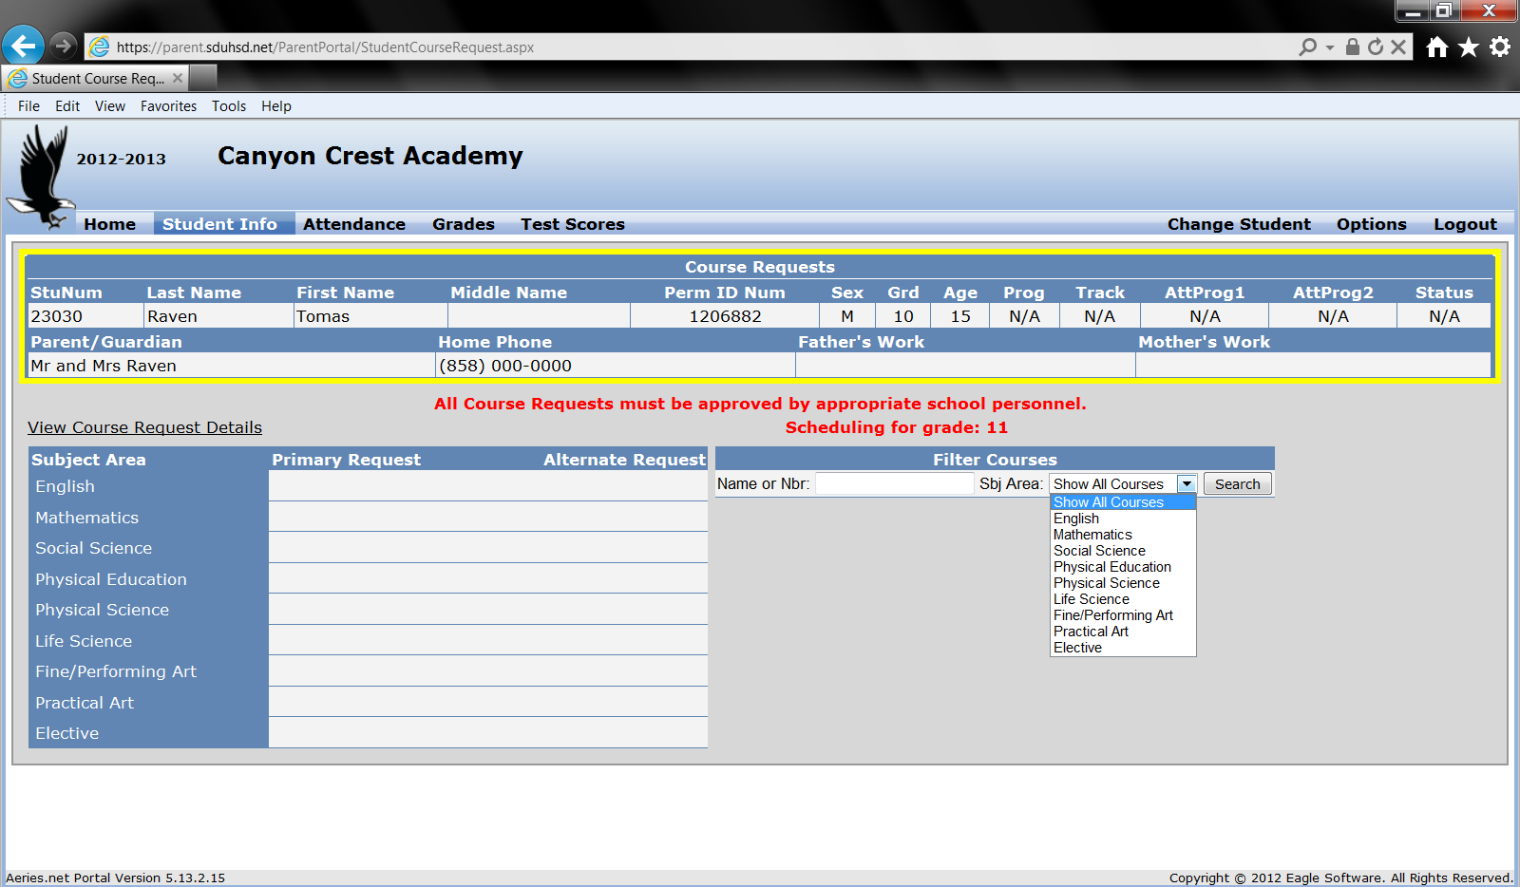
How to Add Courses
Enter course number in the search box

Slide 28
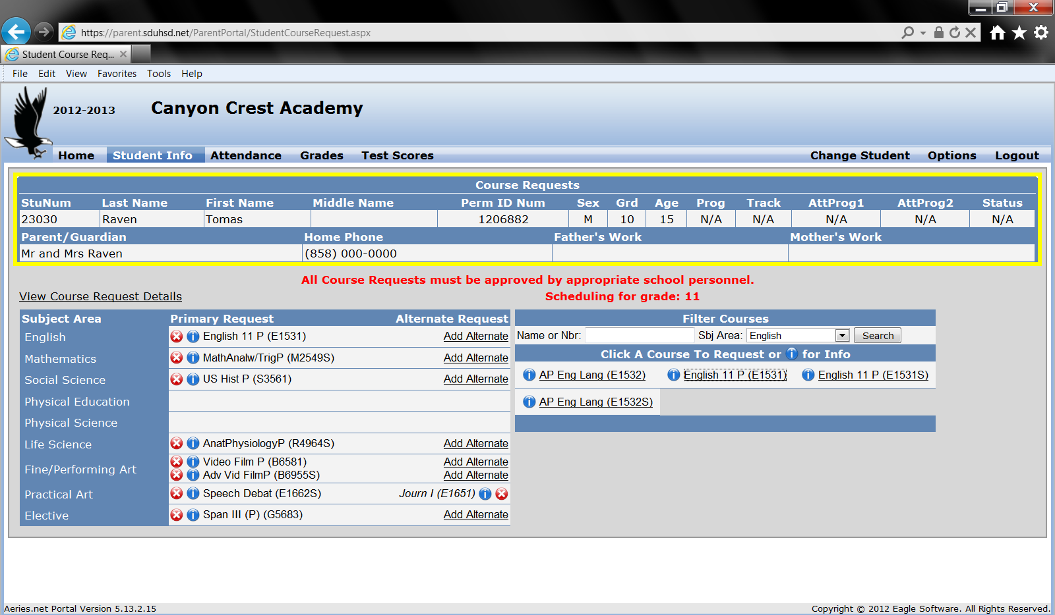
Select Alternate Courses
Choose a total of 8 courses.
4 courses for the Fall term (course number without an “S”)
4 courses for the Spring term (course number with an “S”).
If you need to delete a course click the red X
4. Click “Add Alternate” for each elective course (write at least TWO on the paper contract).
Review your course requests to confirm that the courses you have entered in Aeries match what you have written on your course contract. There is no “submit” or “enter” button.

Slide 29
Course Selection Nights
You must attend the night that corresponds with your last name to turn in your completed Course Selection Contract and required enrollment forms, and to complete the registration process.
Parents and students who have specific questions about course selection will have an opportunity to meet briefly with CCA Staff on their designated night.
Students with last names A - E Monday, April 24, 2017 4:00 - 7:00 pm
Students with last names F - K Tuesday, April 25, 2017 4:00 - 7:00 pm
Students with last names L - Q Wednesday, April 26, 2017 4:00 - 7:00 pm
Students with last names R - Z Thursday, April 27, 2017 4:00 - 7:00 pm
Course Selection Nights are in the CCA Learning Commons

Slide 30
Important Reminders
Choose your classes wisely. Your selections will determine your year-long schedule.
The Course Selection Contract MUST be signed by a parent/guardian.
If you need to review course selection instructions, please visit the CCA Counseling website, Incoming Student Course Selection.
Current SDUHSD middle school students must select courses online via the Aeries Parent Portal AND complete the paper Course Selection Contract prior to their Course Selection Night in the CCA Learning Commons.
All requested forms must be completed fully and the required information provided. If any part of your enrollment package is not complete, you will not be able to continue with the registration process and the counselors will be unable to process your course requests.
In order to be consistent and fair to all incoming students, your designated Course Selection Night will be your only opportunity to meet with us to receive individualized course selection guidance. Please come prepared with your questions so that CCA staff are able to adequately advise you and your student in a timely manner.
If you do not enroll by Friday, April 28, 2017, you will forfeit your spot at Canyon Crest Academy and you will be enrolled at your boundary high school.

Slide 31
THANK YOU &
WELCOME TO
CANYON CREST ACADEMY!
GO RAVENS!!

