Slide 1
Career Planning
CCA Sophomore Audits Class of 2020

Slide 2
Agenda
What to look for in career options
How to conduct career searches
CCA Career Pathways
Skill development and resumes

Slide 3
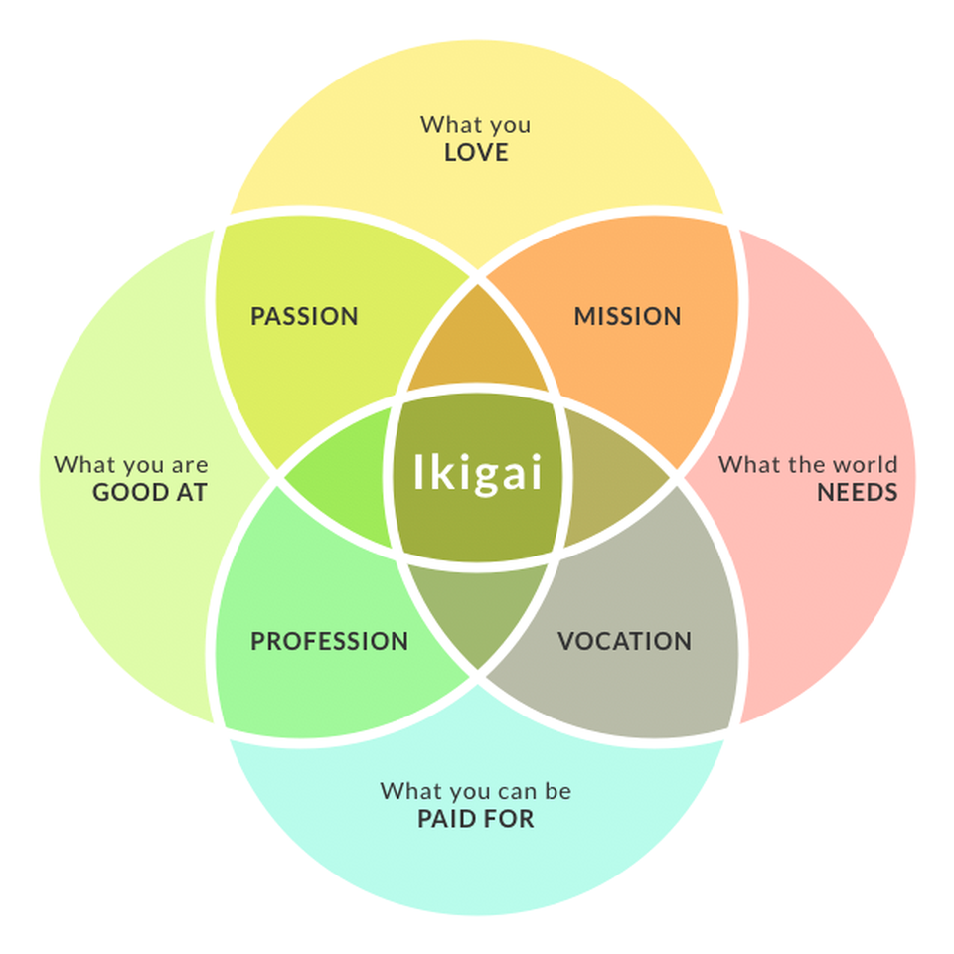
ikigai
Japanese concept meaning “reason for being”
Model when applied to career theory suggests finding an occupation at the intersection of
What you love
What the world needs
What you can be paid for
What you’re good at

Slide 4
Factors Affecting Career Choices
Interests
Skills
Aptitudes
People skills
Experience
Family traditions
Personality
Life goals and work values

Slide 5
CaliforniaColleges.edu

Slide 6
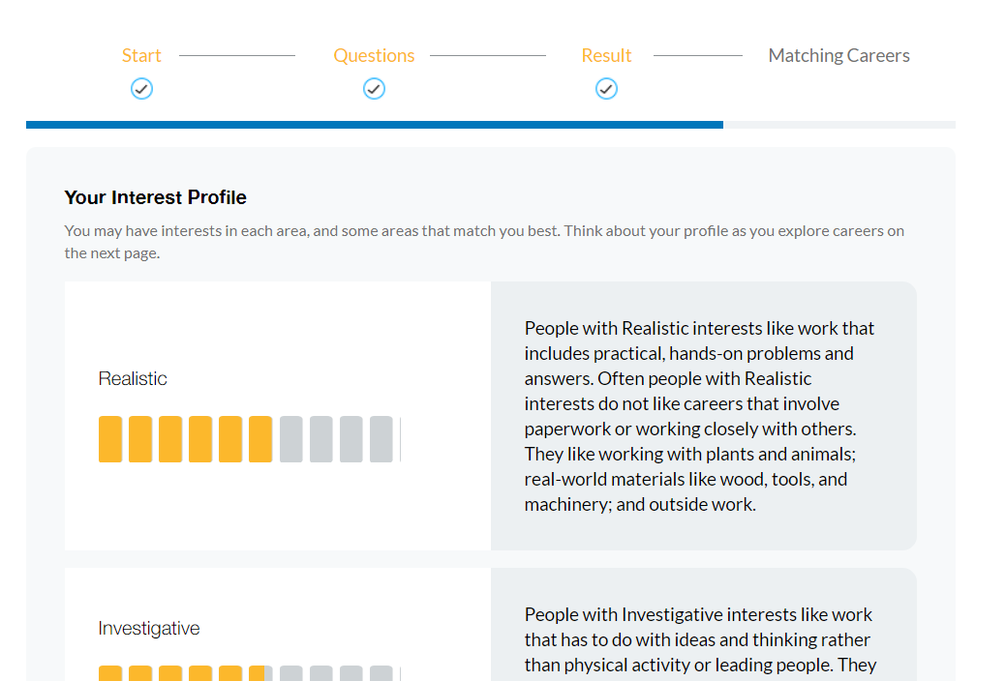
Career Interest Profiler
Asks scaled questions to help determine interest area fit in one of six categories:
Realistic Investigative Artistic Social Enterprising Conventional

Slide 7
Career Interest Profiler
View careers that fit your unique interest profiler
Careers can be compared and saved to your account

Slide 8
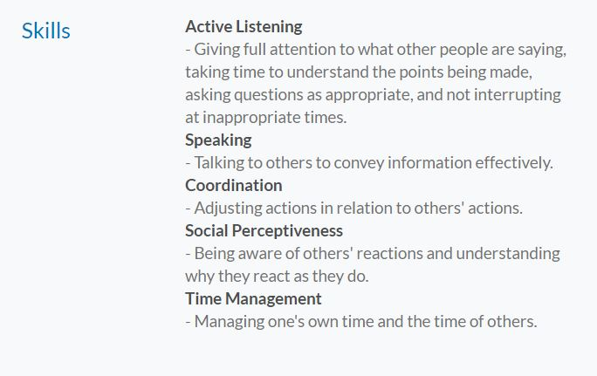
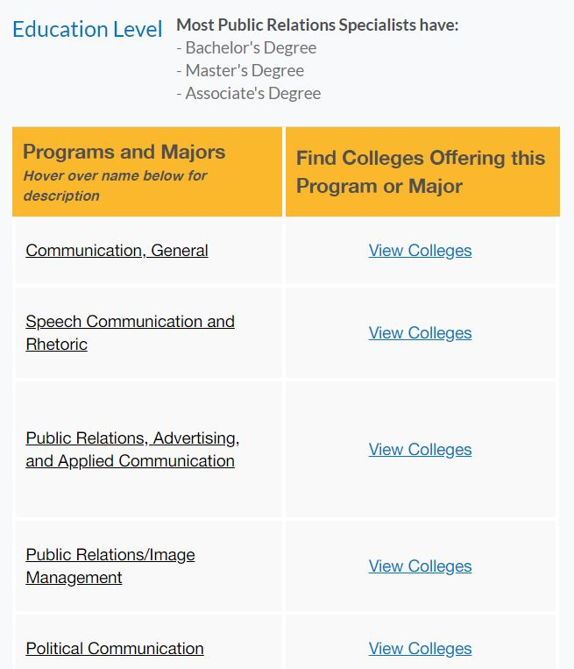
Career Example – Public Relations Specialist

Slide 9
Career Search
Search by name or industry
Identify careers that are “new and emerging” or “growing rapidly”
California Colleges career info links with college search tools

Slide 10
Other career Tools on California Colleges…
Multiple Intelligences
Do what You Are

Slide 11
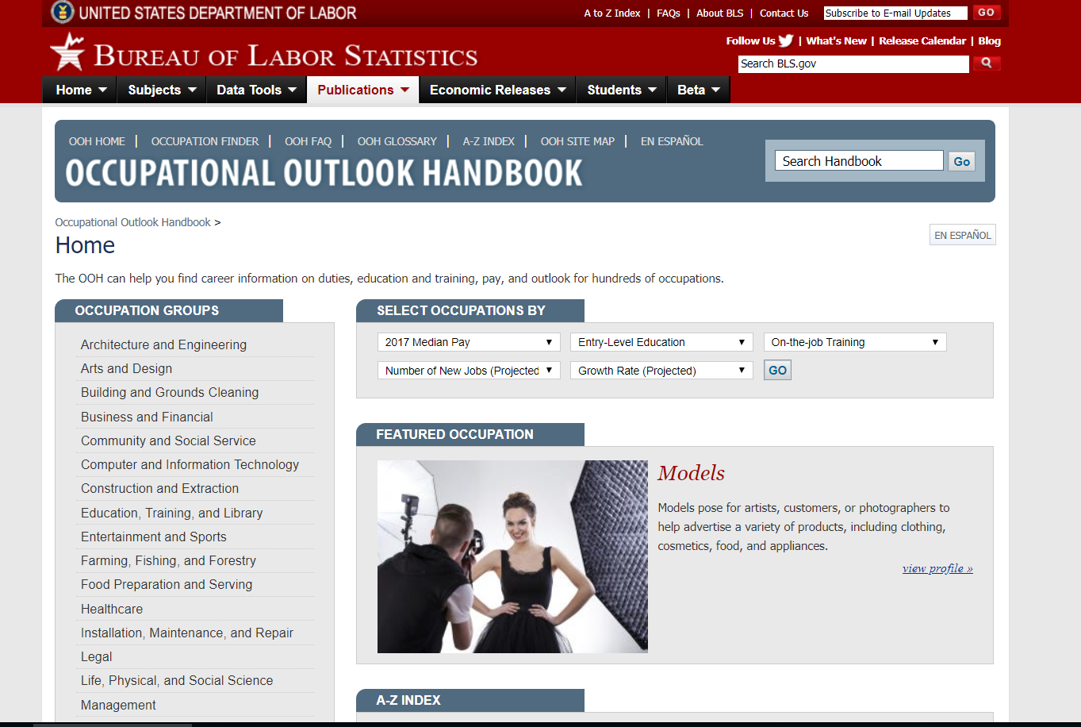
Explore the occupational Outlook Handbook
Keep up with the occupational outlook for various fields.
Get to know which ones are adding jobs and which ones are losing them.
The Occupational Outlook Handbook is an excellent source, and is updated every two years.
https://www.bls.gov/ooh/

Slide 12
CCA Career Pathways
Pathways are a great way to discover interests, explore careers, be prepared for college, and demonstrate a depth of interest in a field on your college application
Completion of a pathway will be indicated on your high school transcript

Slide 13
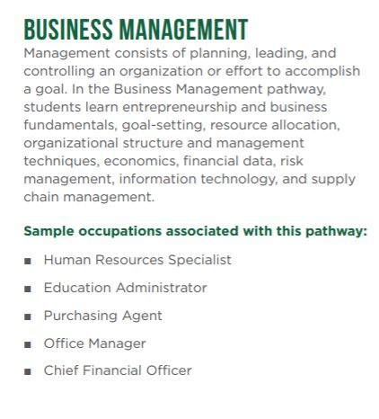
Business & Finance Sector: Business Management Pathway
CCA Courses: Intro to Business Management, Marketing Principles, Advanced Business Management, Business Math

Slide 14
Arts, Media, and Entertainment Sector
CCA offers four pathways within this sector:
Design, Visual, and Media Arts
Graphic Design
Production and Managerial Arts (or Film, Video Production)
Performing Arts/Professional Music

Slide 15
Pathway Options
Design, Visual, and Media Arts & Graphic Design
Design, Visual, and Media Arts CCA Courses: Fine Art Digital Photography, Photo Imaging, Advanced Fine Art Digital Photography Graphic Design CCA Courses: Drawing and Design, Digital Art and Design, Advanced Digital Art and Design

Slide 16
Pathway Options
Production and Managerial Arts (Film, Video Production)
Performing Arts/Professional Music
CCA Courses: Video Film, Advanced Video Film, Cinema Lab, Digital Media Production, Cinema Conservatory
CCA Courses: Digital Composition, Recording Arts, Advanced Recording Arts, Rock Band Music Industry

Slide 17
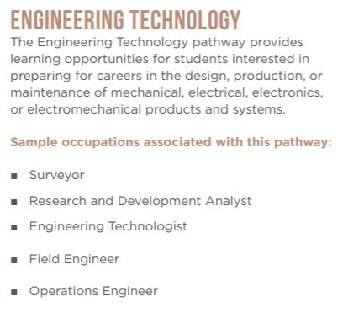
EnGINEERING AND Architecture sector: Engineering Technology pathway
CCA Courses: Intro to Engineering Techniques, Digital Electronics, Advanced Engineering and Technology, Robotics and Engineering

Slide 18
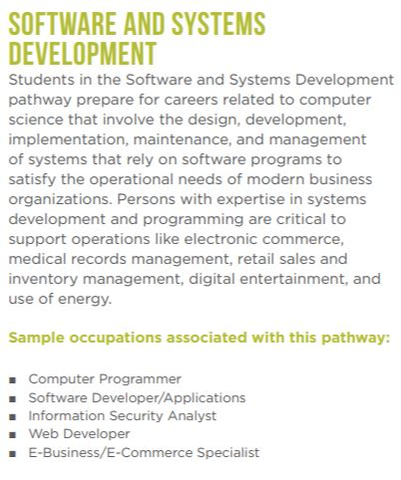
Information and communication technoglogies sector: Software, Systems Development pathway
CCA Courses: Exploring Computer Science, Computer Game Design, AP Computer Science Principles, AP Computer Science A

Slide 19
Top 10 Skills Employers Want to See
Communication Skills – writing, speaking, listening
Interpersonal – relating with others
Time Management
Creativity Skills
Adaptability – flexibility
Teamwork
Leadership
Work Ethic
Problem-solving
Research & Analytical Skills
You can develop these skills through your course work, clubs, athletics, volunteering, work experience, and other extracurriculars

Slide 20
Building a resume
What goes on a resume?
Name and contact information
Objective or summary statement (optional)
Work experience
Volunteer or extracurricular experience
Education
Skills
Find the resume template on the CCA Counseling website

Slide 21
Things to Consider…
Explore a number of careers and majors
Get involved
Get advice from people in your target occupation
Follow your passion
Dare to try something new
Explore the major offerings at colleges on your list
Visit the Career Counseling office when you get to college

